Slide 1

LvivRouter

Slide 2
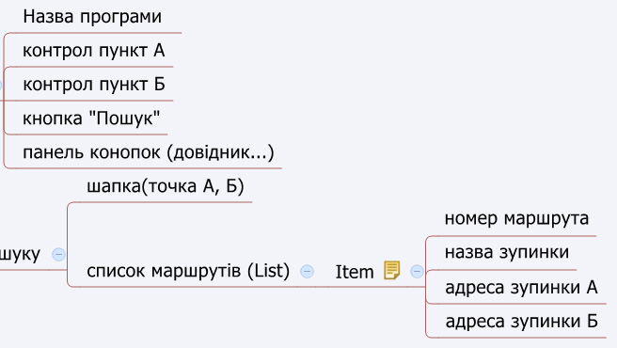
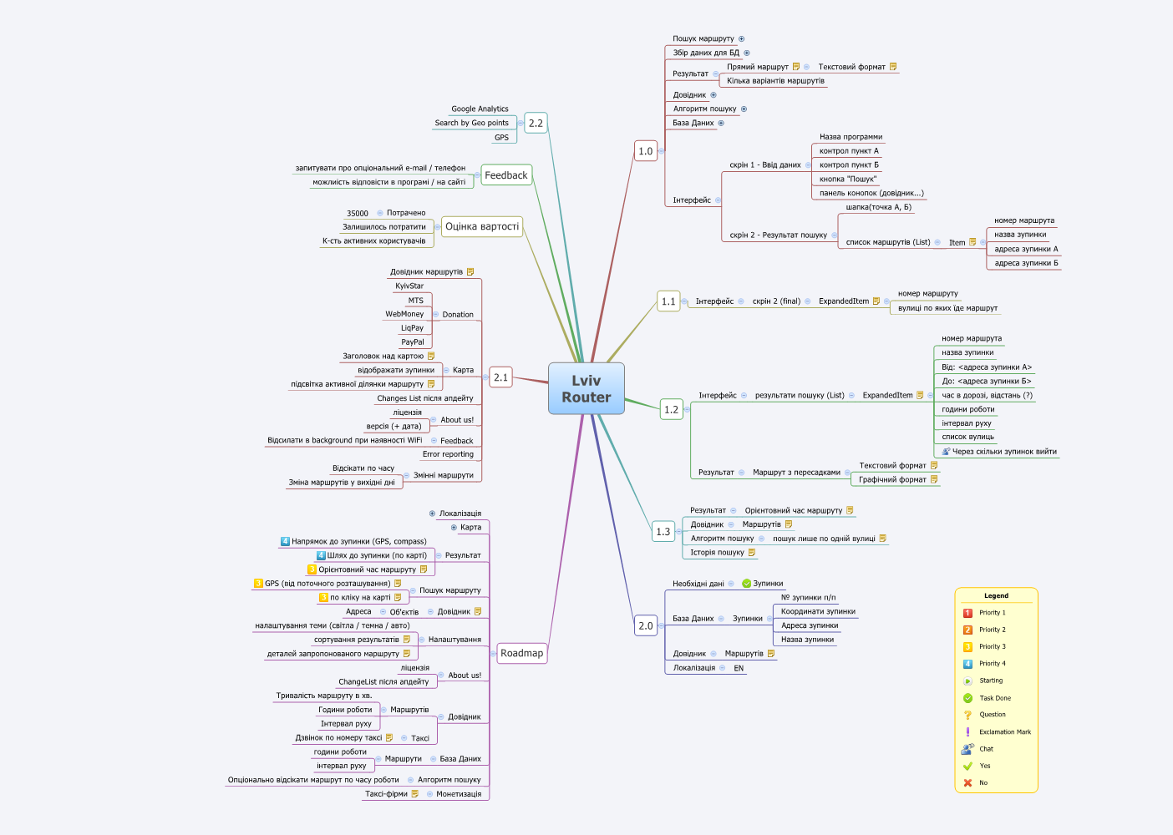
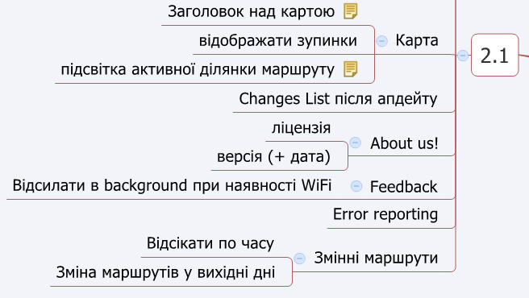
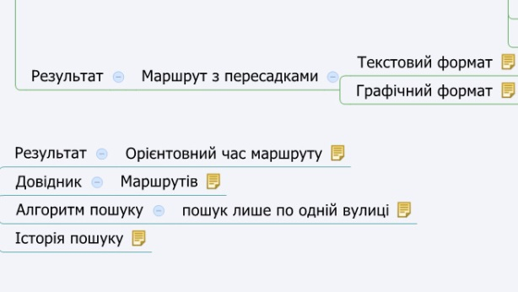
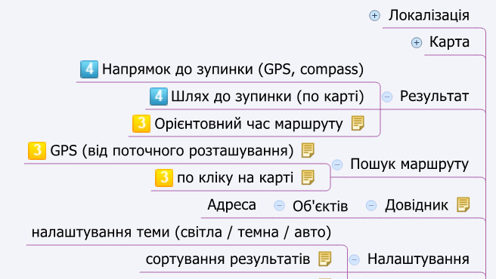
MIND MAP

Slide 3
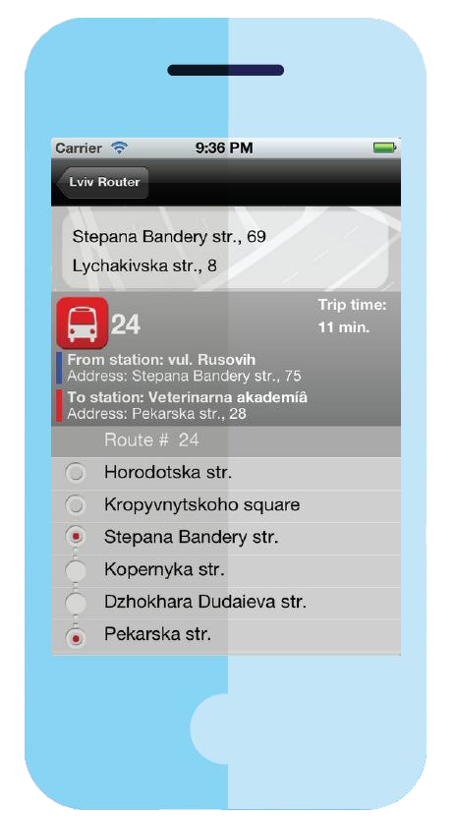


Lviv router Structure
Map
Data Base
Lviv Router
Server

Slide 4
Data base structure
Static
Dynamic
Routes
Stations
Streets
Buildings
Stops

Slide 5
Data base static resources
Post index
Google Maps
Mapia

Slide 6
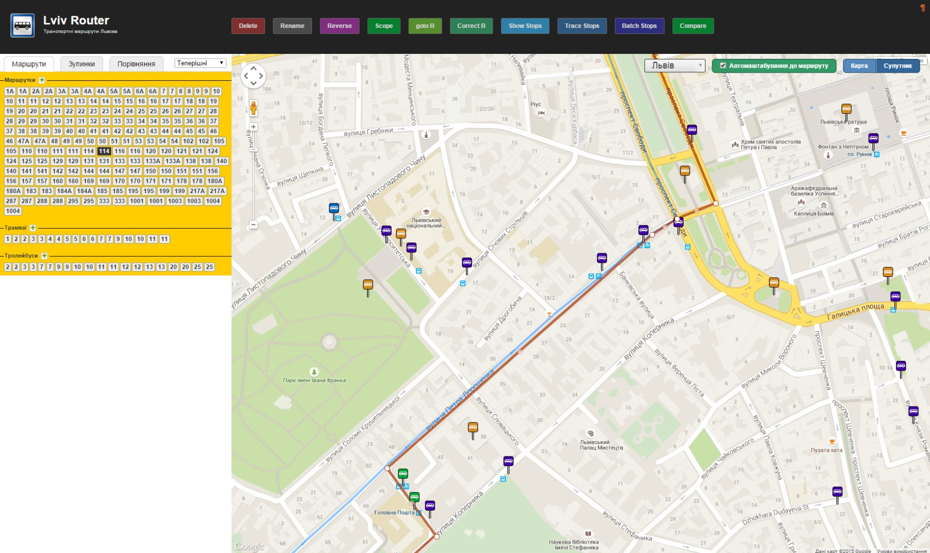
Application management system

Slide 7
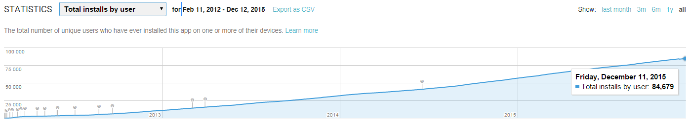
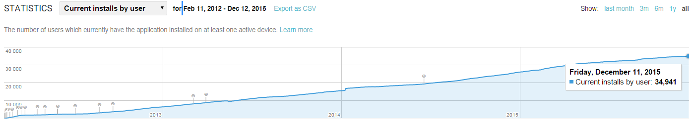
Statistics
Total installs by user – 84,679
Current installs by user – 34,941

Slide 8

Yuriy Ohrodniychuk
CEO
Software Engineer. 15+ years of experience in development. Co-founder of UkrInSofT Company (Lviv).
CONTACT INFORMATION
fb.com/yura.ohrodniychuk
yohrodn@ukrinsoft.com
Skype: o-yurij

